Slide 1
Hydra VM: Extracting Parallelization From Legacy Code Using STM
Mohamed M. Saad & Mohamed A. Mohamedin

Slide 2
Execution Flow Graph
Static Execution Graph
Nodes; can be either
Basic Blocks; a sequence of non-branching instructions
Variables
Edges; represents the frequency of access
Dynamic Execution Graph
Capture the behavior of the code across the time (i.e. relation between block and itself in the future)

Slide 3
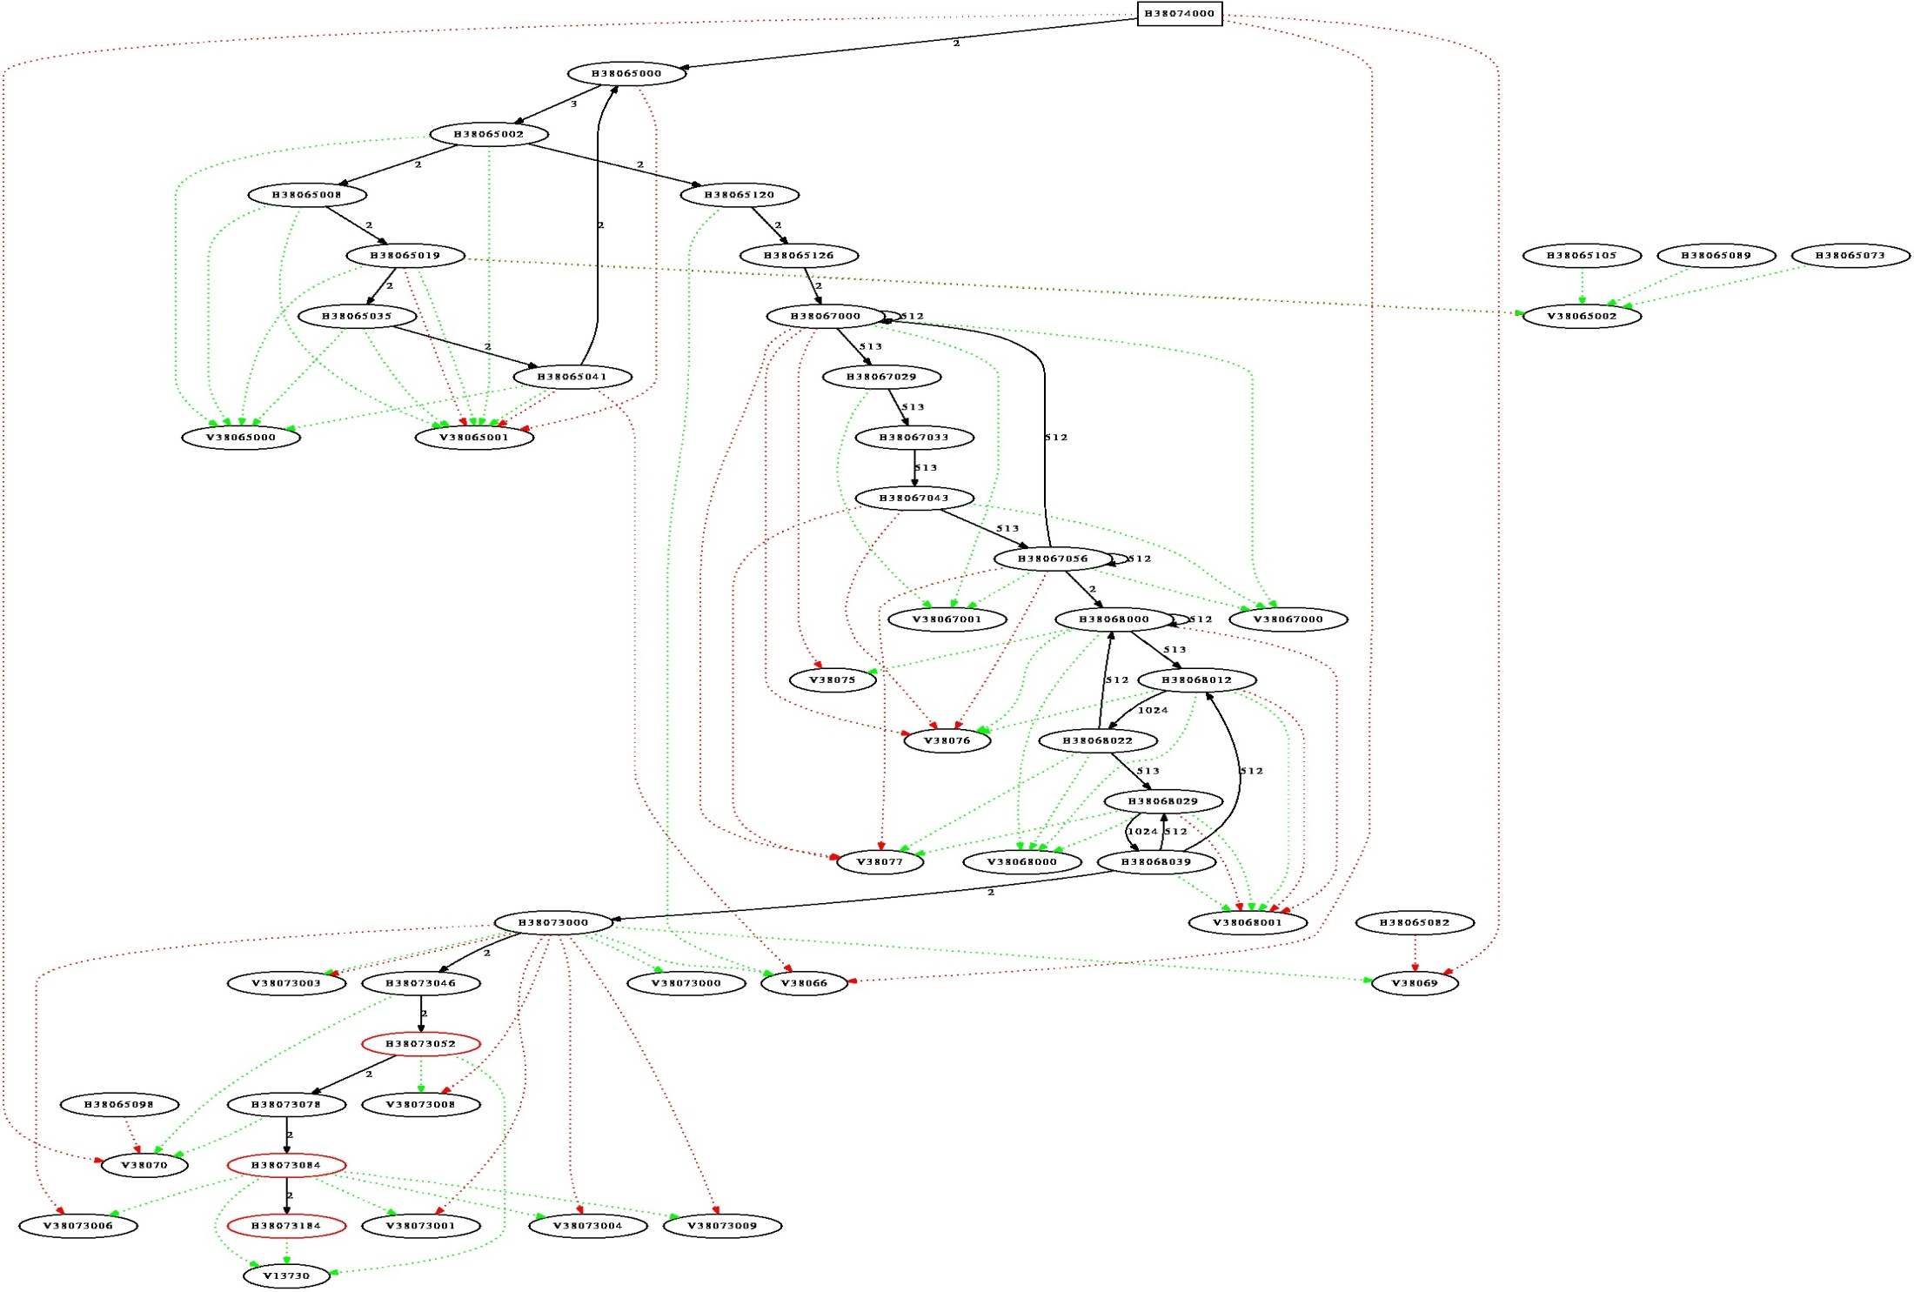
Example: Jolden “Treeadd”

Slide 4
Example: Jolden “Perimeter”

Slide 5
Superblock
Superblock; is a set of basic blocks, it has multiple entries, multiple exists.
The suitable Entry & Exist are determined at runtime
`

Slide 6
Superblock
Grouping of blocks
Hot-Path detection
Static data access analysis
Violations
Reference Tracking (e.g. function calls)
Memory Arithmetic (e.g. arrays)
STM will handle these violations
Reconstruction (OoO handling)
Control Dependencies

Slide 7
Superblock extraction
0: getstatic #13; //Field java/lang/System.out:Ljava/io/PrintStream; 3: ldc #19; //String start 5: invokevirtual #21; //Method java/io/PrintStream.println:(Ljava/lang/String;)V 8: iconst_0 9: istore_1 10: invokestatic #27; //Method java/lang/Math.random:()D 13: ldc2_w #33; //double 0.3d 16: dcmpl 17: ifle 26 20: iinc 1, 1 23: goto 29 26: iinc 1, -1 29: getstatic #13; //Field java/lang/System.out:Ljava/io/PrintStream; 32: ldc #35; //String end 34: invokevirtual #21; //Method java/io/PrintStream.println:(Ljava/lang/String;)V
37: return
1
System.out.println(“start"); int counter=0; if(Math.random()>0.3) counter++; else counter--; System.out.println(“end");
2
3
4
5

Slide 8
Superblock extraction
0: getstatic #13; //Field java/lang/System.out:Ljava/io/PrintStream; 3: ldc #19; //String start 5: invokevirtual #21; //Method java/io/PrintStream.println:(Ljava/lang/String;)V 8: iconst_0 9: istore_1 10: invokestatic #27; //Method java/lang/Math.random:()D 13: ldc2_w #33; //double 0.3d 16: dcmpl 17: ifle 23
20: hydra_iload 2 22: ireturn
23: iinc 1, -1
26: hydra_iload 4 28: ireturn
System.out.println(“start"); int counter=0; if(Math.random()>0.3) counter++; else counter--; System.out.println(“end");
0: getstatic #13; //Field java/lang/System.out:Ljava/io/PrintStream; 3: ldc #19; //String start 5: invokevirtual #21; //Method java/io/PrintStream.println:(Ljava/lang/String;)V 8: iconst_0 9: istore_1 10: invokestatic #27; //Method java/lang/Math.random:()D 13: ldc2_w #33; //double 0.3d 16: dcmpl 17: ifle 26
23: iinc 1, -1

Slide 9
Challenges
Synchronizing the same local variables after being split in two or more superblocks blocks
Detecting thread memory access reads/writes at VM level (STM)
Dynamic Execution Graph (loops handling)
OoO handling & Control Dependencies
Irrevocable blocks (i.e. I/O operations)
Strong Atomicity
Exploiting parallelization with Arrays

